Slide 1


Electric Vehicle Support Infrastructure Case Study 2
Hiba Lubbad

Slide 2
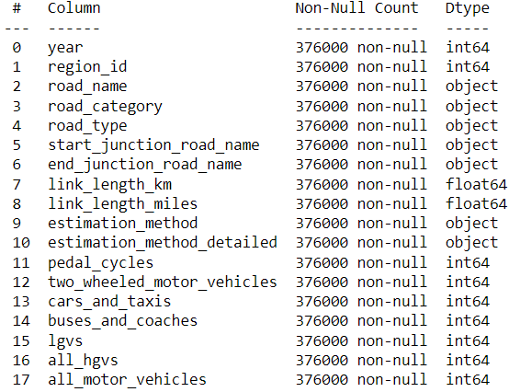
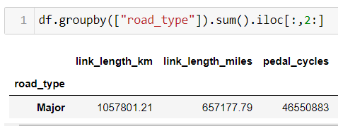
Traffic Data
Historic data from 2000 to 2020 of UK traffic.
The purpose of this study is to
Extracts Insights
Perform regression analysis to estimate future traffic.
Estimate electric vehicles growth and generation capacity required
Provide recommendations concerning the additional generation
After dropping unnecessary columns and Na’s
All minor roads data were missing and decided to drop them.
Notes:
This study uses the dataset provided by the UK government shows traffic of different vehicle types across different regions from 2000 till 202 . After observing the data, the minor rodas data was missing and was coletely dropped.

Slide 3
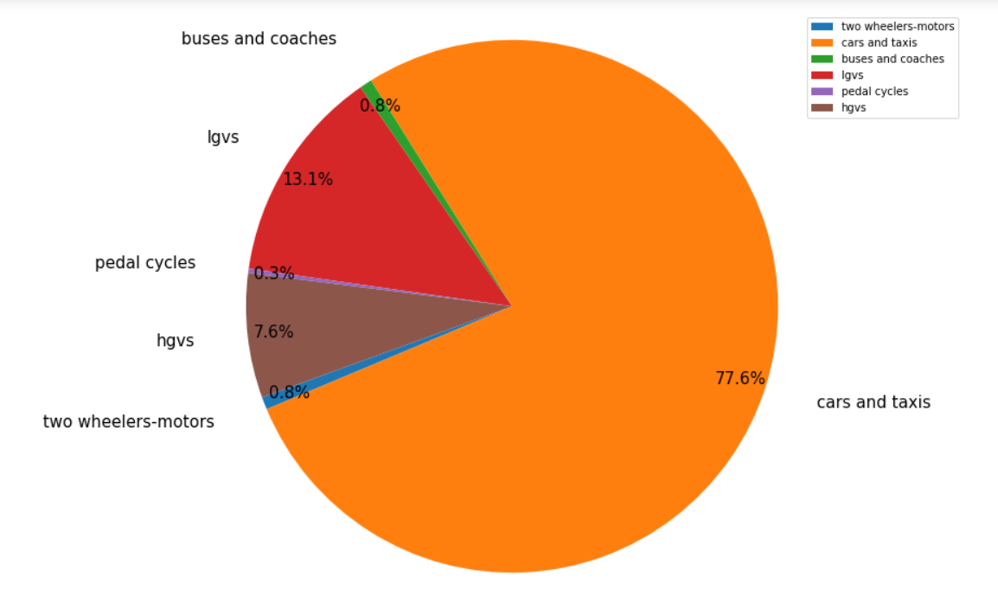
Overview

Slide 4
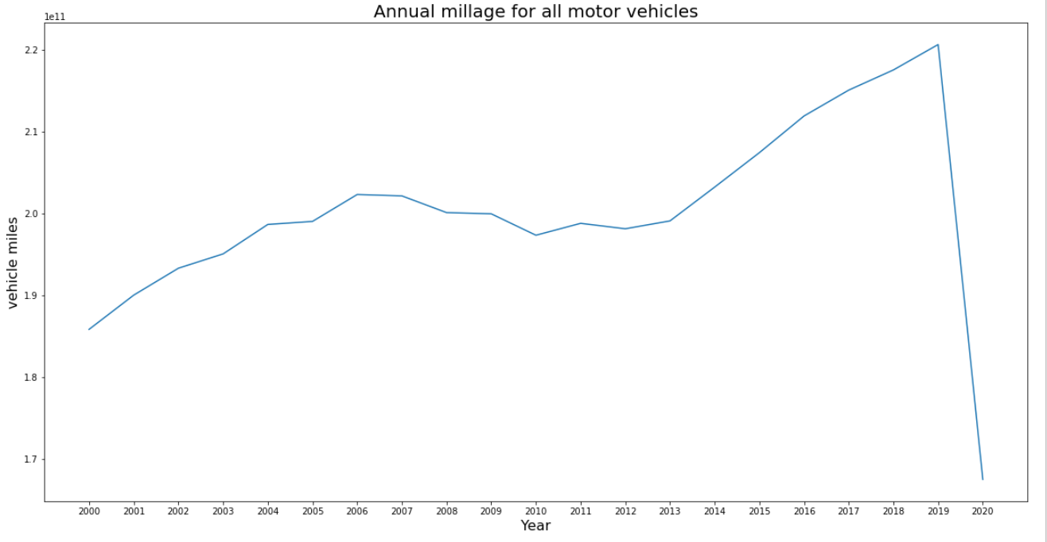
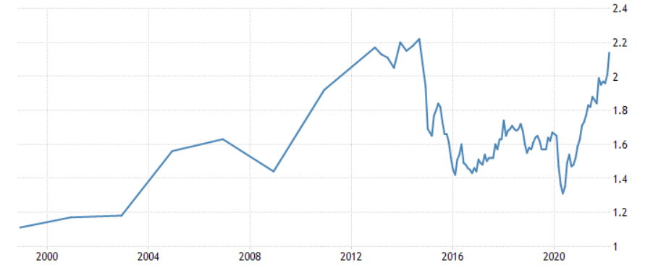
Annual millage for all motor vehicles
19 % increase in total UK millage through years 2000 to 2019.
Affordability and popularity of vehicles
Sharp decrease of 24% between the years 2019 and 2020 that could be largely attributed to lockdown during COVID-19
The dips and rises can be due to changes in fuel prices and economic downturns
Notes:
I began by calculating the annual millage for all motor vehiv;es and as the graph on the right displays there is an aoveral increase of 19% in the mileage over the years from 2000 till 2019 and while there was a sharp decrease of 24% that could be largely attributed to lockdown during COVID-19
The dips and rises can be due to changes in fuel prices and economic downturns

Slide 5
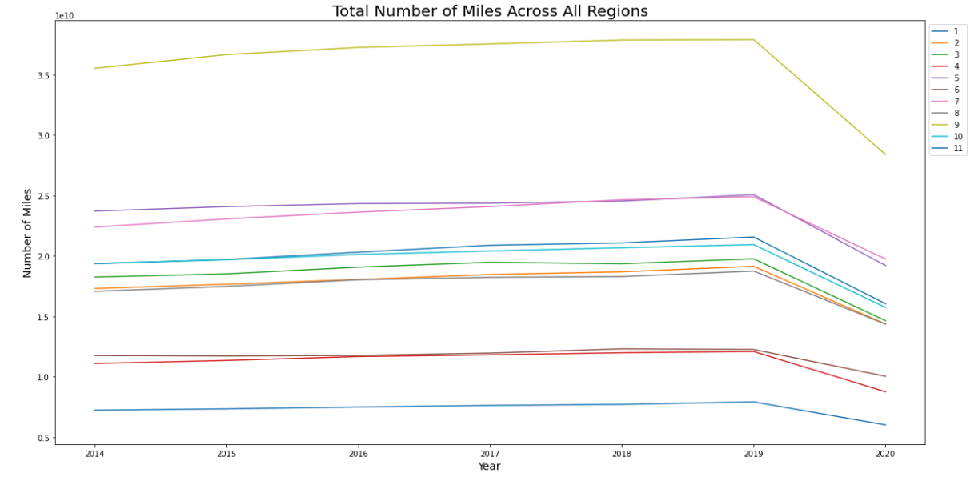
Annual millage per Region
Most regions follow similar trend and a sharp drop in mileage in 2019 is experienced among the UK.

Slide 6
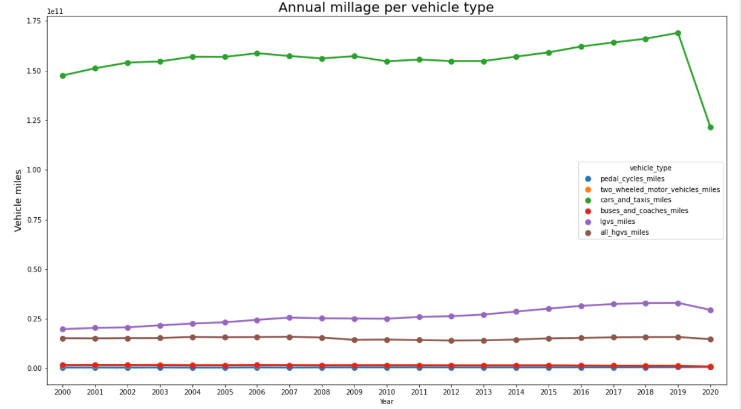
Annual millage per vehicle type
Cars and LGVs most responsible for trend changes
Cars annual millage starts to increase around 2013 → 14% and a shocking decrease of 28 %
LGVS → 40% increase
Other vehicle type display constant millage with slightly notable decrease around 2019

Slide 7
Time Series Forecasting Models
ARIMA, SARIMA
Prophet
Exponential smoothing
LSTM
Notes:
Prophet isOne of most widely used approaches to time series forecasting
robust to missing data and shifts in the trend, and typically handles outliers well.

Slide 8
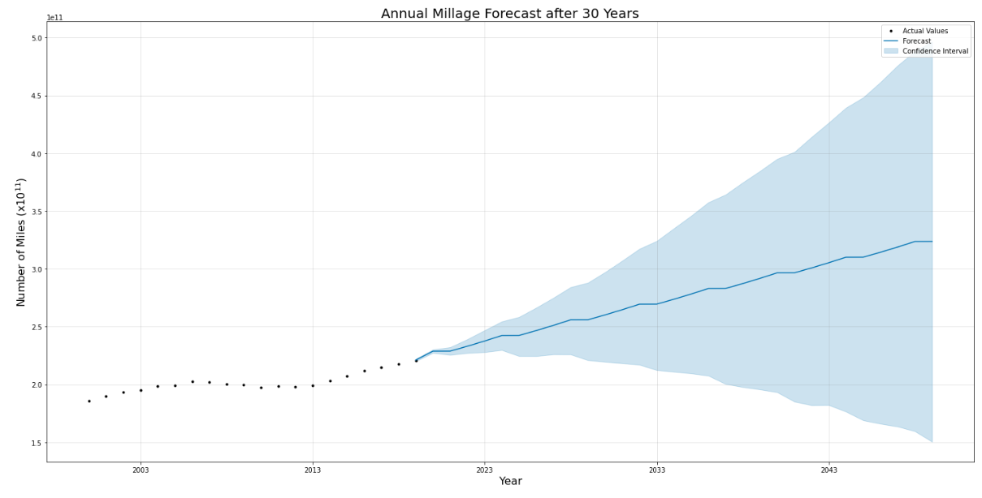
Regression Analysis

Slide 9

Research

Slide 10
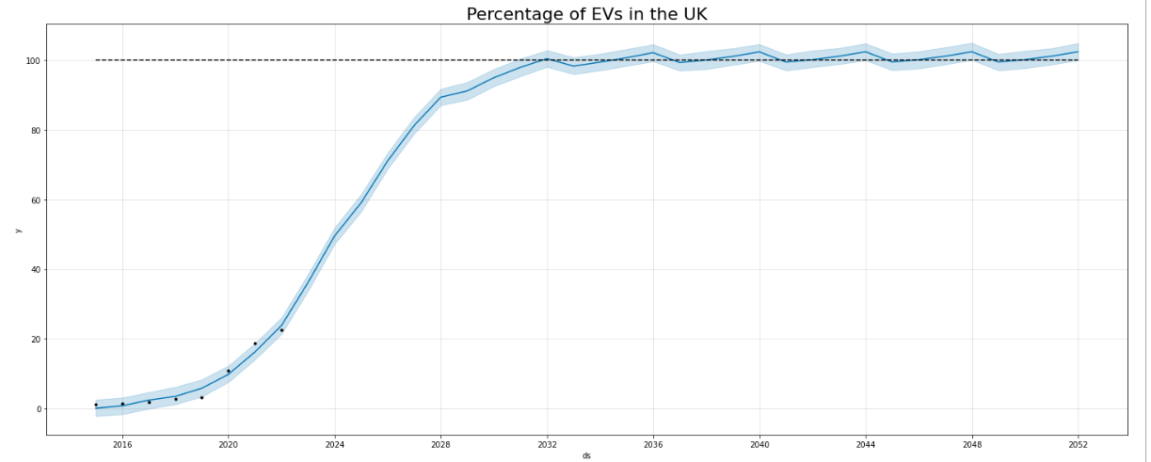
UK’s Shift to Zero Emission Vehicles
UK’s 2030 Ban on Non EV
Availability/Affordability of models
Number of charging ports increasing, more accessible

Slide 11
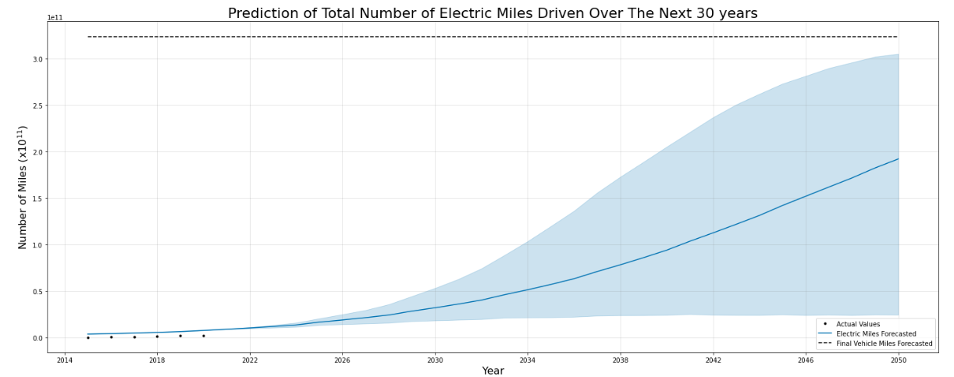
Forecasting number of electric miles driven each year

Slide 12
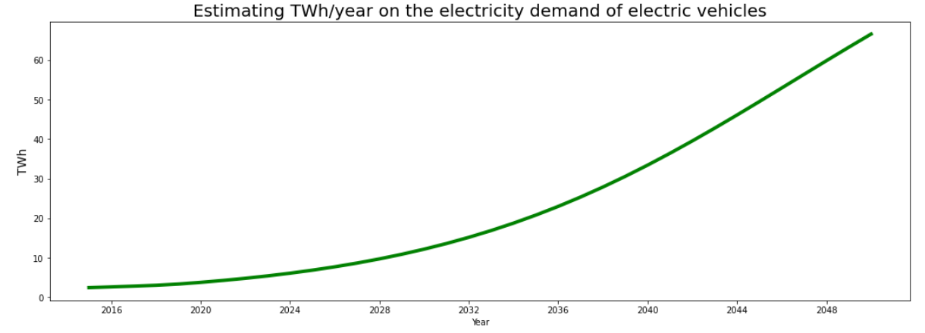
Estimated power generation
Using the estimated electric miles driven
Using average energy consumption of 340 Wh/mi
Calculated from the energy consumption of an Electric Vehicle Database

Slide 13
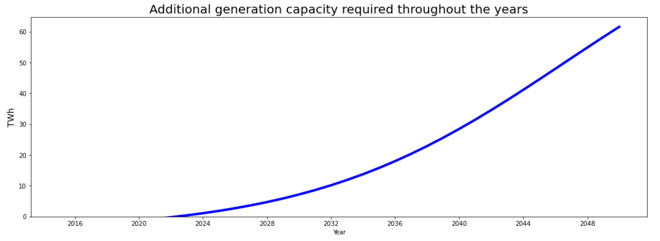
Calculated Additional Power Generation Required

Slide 14

Recommendations
Notes:
ff

Slide 15
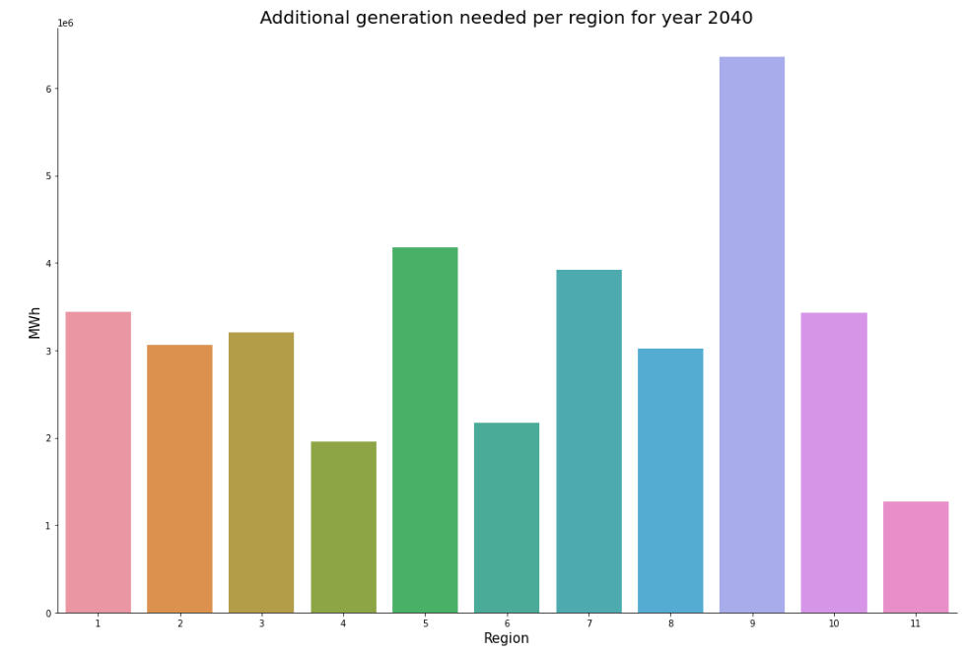
Notes:
In order to make recommendations on the UK’s required electricity generations I have decided to breakdown the required generattions per region to understand how the distribution should be handled

Slide 16
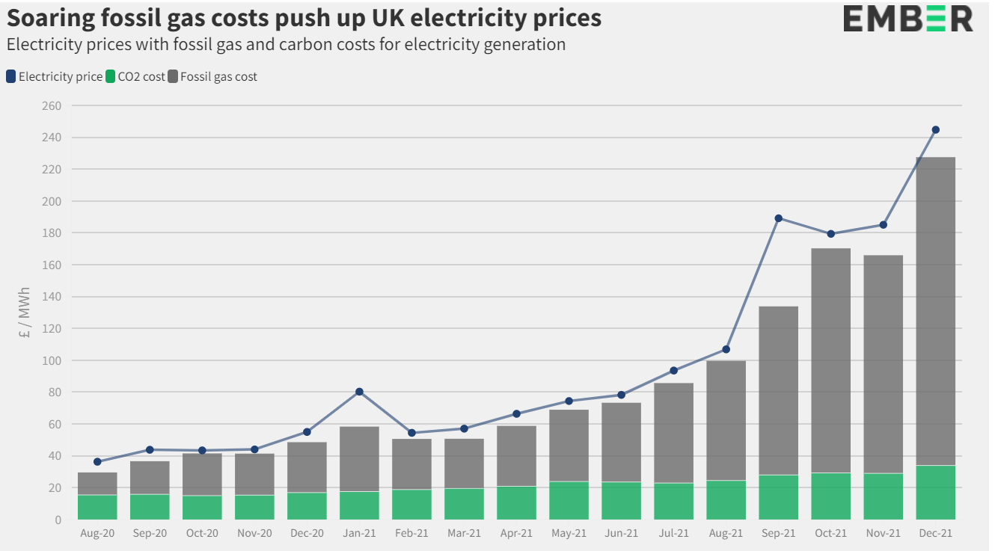
Soaring fossil gas costs

Slide 17
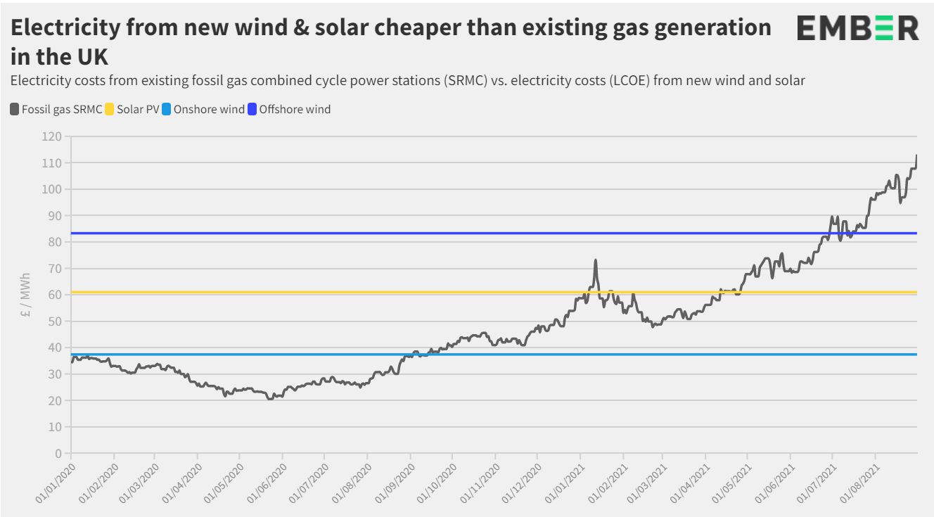
Renewable Energy is Key

Slide 18
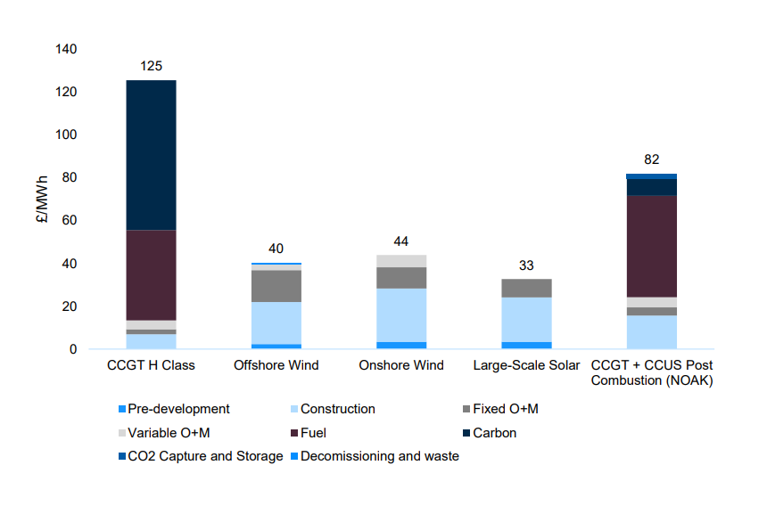
Levelised Energy Cost Estimates by 2040

Slide 19
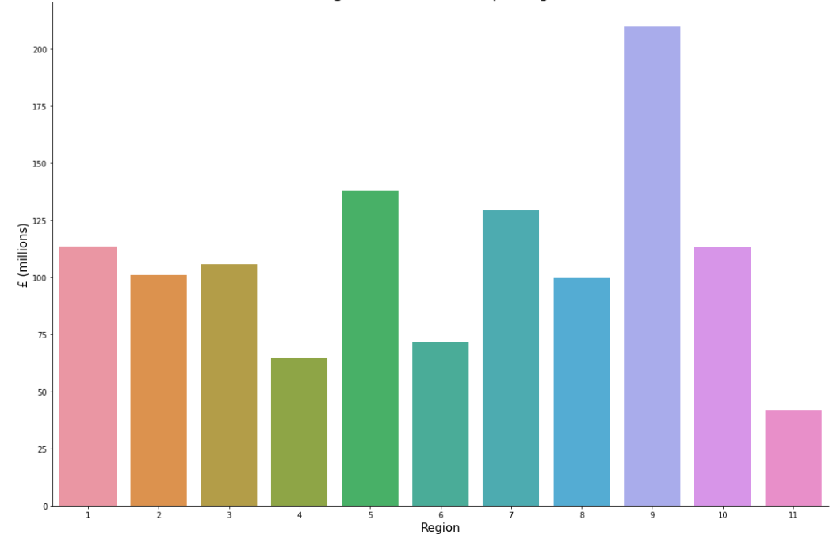
Large-Scale solar costs per regionto cover by 2040

Slide 20
Recommendation Comments
combination of renewable power and resulted in cost savings of up to 25 per cent:
Offshore/ onshore wind
solar
biogas
battery power
Taking advantage of region positioning:
London – Wind, Solar
Seaside regions – Offshore Wind

Slide 21

The end

